Slide 1




Project Reaqtor Your Rx for Distributed, Reliable, and Stateful Event Processing
Bart J.F. De Smet Sr.
Principal Software Development Engineer

Slide 2
Agenda
What is Reaqtor?
Official Release of Reaqtor
Reaqtor in Action

Slide 3
What is Reaqtor?
Your Rx for Distributed, Reliable, and Stateful Event Processing

Slide 4

Reactive Extensions (Rx)
overall_1_132241972397315101 columns_1_132241972397315101
public interface IObservable<out T>
{
IDisposable Subscribe(IObserver<T> observer);
}
public interface IObserver<in T>
{
void OnNext(T value);
void OnError(Exception error);
void OnCompleted();
}

Slide 5
LINQ to Events
IObservable<string> search =
from e in Observable.FromEventPattern<EventArgs>(txt, "TextChanged") // .NET Events
select txt.Text;
IObservable<string[]> res =
from term in search.Throttle(TimeSpan.FromMilliseconds(100)).DistinctUntilChanged()
where term.Length > 0
from words in svc.GetSuggestionsAsync(term).AsObservable() // Task<T> conversion
select words;
IDisposable sub = res.ObserveOn(lst).Subscribe(words => lst.Items = words);

Slide 6
Taxonomy of Querying
overall_1_132241972397315101 columns_1_132241972397315101
Pull
Push
IEnumerable<T> xs
from x in xs where f(x) …
IObservable<T> xs
from x in xs where f(x) …
Code
IQueryable<T> xs
from x in xs where f(x) …
IQbservable<T> xs
from x in xs where f(x) …
Data

Slide 7

History of Reaqtor
LINQ (2007)
Volta (2010)
Reactor (2013)
Rx (2011)
Reaqtor (2020)
…
Taking research to production
Many detours and tangents
Long path to OSS
Hundreds of man years
Find the FREE e-book at reaqtive.net

Slide 8
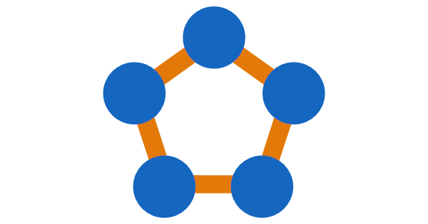




The Reactor Service
overall_1_132241972397315101 columns_1_132241972397315101
1st party internal service at Microsoft (2013-…)
Built on Service Fabric
Scalable, distributed, reliable, and stateful Rx-based event processing
Running at scale in Bing, Office 365, etc.
Billions of standing event processing queries
Thousands events/second in near real-time
Built as a set of reusable libraries
Embedding in applications, devices, etc.
Hosting in large scale cloud services

Slide 9
Planetary Scale
Stream Reservoir
Reliable event delivery
Rx/Tx 10³⁻⁴ events/second
Query Coordinator
Smart query placement
10²⁻³ DDL operations/second
Query Evaluator
10⁴⁻⁵ of replicated query engines
Hosting 10⁴⁻⁶ queries each
Spanning many data centers

Slide 10

IReactiveProcessing ➔ Reaqtor
Highly reusable set of libraries
Scalable from cloud to device
Pluggable and extensible

Slide 11



Project Reaqtor
1st party services powered by

Slide 12

Project Reaqtor
overall_1_132241972397315101 columns_1_132241972397315101
OSS release of the core libraries on github.com/reaqtive
Collaboration between
Layered architecture
Nuqleon – General-purpose functionality (e.g., expression tree serialization)
Reaqtive – Evolution of Rx for reliable and distributed event processing
Reaqtor – Components to build event processing services (e.g., query engines)

Slide 13


Project Reaqtor
3rd party services
Built on
technology
Any cloud, any edge
https://reaqtor.cloud
‘s on

Slide 14
Reaqtor 101
Seattle-Tacoma Airport – ARRIVALS
@ HttpPostUri observer
FlightBoardUri
IQbserver<HttpData>
Where filter
Select project
@ HttpPostUri observer
Reaqtor
IQbservable<Flight>
IObserver<HttpData>
@MyDemoUri
@ FlightUri stream
Where filter
Select project
IObservable<Flight>
Consumer
ctx
Proxy
@ FlightUri stream
var flights = ctx.GetObservable<Flight>(FlightUri);
var httpPost = ctx.GetObserver<HttpData>(HttpPostUri);
await flights.Where(f => f.Destination == “SEA”)
.Select(f => new HttpData { Body = f.Status,
Uri = FlightBoardUri })
.SubscribeAsync(httpPost, MyDemoUri);
IObserver<Flight>

Slide 15

Reaqtor 101
Seattle-Tacoma Airport – ARRIVALS
Seattle-Tacoma Airport – ARRIVALS
BA49 04:25 London Heathrow +00:30
Producer
FlightBoardUri
var flights = ctx.GetObserver<Flight>(FlightUri);
await flights.OnNextAsync(new Flight {
Code = “BA49”, Origin = “LHR”, Destination = “SEA”,
ArrivalTime = new DateTime(2014, 6, 11, 16, 25, 0),
Delay = TimeSpan.FromMinutes(30)
});
@ HttpPostUri observer
Reaqtor
IObserver<HttpData>
@MyDemoUri
Where filter
Select project
IObservable<Flight>
@ FlightUri stream
Proxy
ctx
@ FlightUri stream
IQbserver<Flight>
IObserver<Flight>

Slide 16
Cortana Queries
Temporal query operators
flights
.Where(f => f.Code == “BA49”)
.DelaySubscription(departure – TimeSpan.FromDays(1))
.TakeWhile(f => f.Status != FlightStatus.Landed) .Select(f => f.Status)
from w in weather where w.City == “Seattle”
select w
userLocation
.Sample(TimeSpan.FromMinutes(1))
.DistinctUntilChanged()
.Select(here =>
traffic(here, meeting.Location)
.TakeUntil(meeting.StartTime – minimumTime)
.Select(route => Timer(meeting.StartTime – route.EstimatedTime))
.Switch())
.StartWith(Timer(meeting.StartTime – estimatedTravelTime))
.Switch()
.Single(_ => “Leave now for ” + meeting.Title)
.DelaySubscription(meeting.StartTime – (estimatedTravelTime + slack))
Device-side event stream
Cloud-side event stream
Higher-order query operators

Slide 17
Official Release of Reaqtor
reaqtive.net
github.com/reaqtive/reaqtor

Slide 18

Going Live on GitHub
Notes:
Call to action:
Star the repo
Clone the repo
Link to http://reaqtive.net
Add e-book picture

Slide 19
Reaqtor in Action
Time for some demos

Slide 20

Real-Time Vessel Tracking

Slide 21
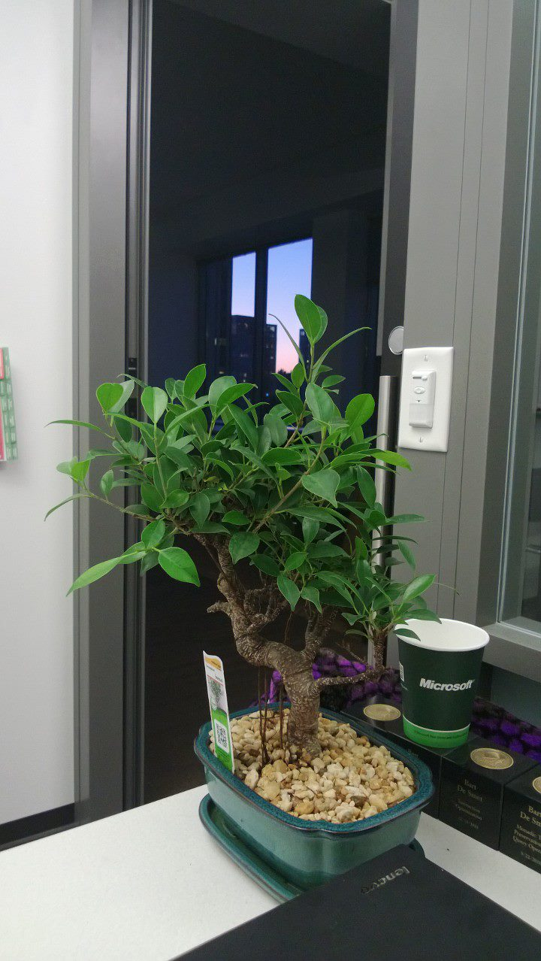
Reaqtor Core Ingredients Expression Trees
Reaqtor does not invent its own query language
Piggyback on in host languages
For example, .NET Expression Trees
Ship expression trees
Normalization – Decouple client and service
Validation – Reject dangerous code
Serialization – “Bonsai” expression trees
Optimization – Expression tree rewrites
Evaluation – Efficient evaluation of lots of trees

Slide 22

Expression Tree Serialization

Slide 23
Reaqtor Core Ingredients Reliable Rx
Reactive Extensions (Rx) has volatile state
For example, the Take operator stores a count
Need a way for an Rx “subscription” to outlive a process
Reaqtive supports state persistence (and more)
ISubscription provides visitor support
Schedulers with pause/resume capability
Rx-compatible operators with state persistence
Reliable variants of interfaces with sequence numbers

Slide 24

Reliable Stateful Reactive Computation

Slide 25
Reaqtor Core Ingredients Checkpointing query engine
Hosting for running queries
Efficient periodic persistence of state using pluggable storage
Transaction log of create/delete operations
Expression trees for reactive artifacts
State of query operators
Bridges with external streams with replay support
Sequence numbers
Acknowledge on checkpoint, replay on recovery
Supports high density of running queries
Range from 1 to 1000s of queries
Checkpoint/recovery latency is key factor in partitioning
Library approach enabling variety of hosting

Slide 26

A Look Inside the Query Engine

Slide 27
& A
⭐ The GitHub Repo:
https://github.com/reaqtive/reaqtor
📖 Download the free ebook “A Little History of Reaqtor”:
https://reaqtive.net
📚 Read the conceptual & API documentation:
https://reaqtive.net/documentation/
🕹 Play with the demos and .NET Interactive notebooks:
https://reaqtive.net/demos/
🎨 Look at the “creative commons share alike” design assets :
https://github.com/reaqtive/reaqtive-creative-assets
👄 Give a Reaqtor presentation to your local user group:
https://github.com/reaqtive/community-presentations
🙏 Follow @reaqtive and @reaqtor on Twitter!
📣 Spread the word! Blog, tweet, podcast, vlog, subscribe to our blog!

